Slide 1
Optimizing the Wait:
Data-Driven Patient Flow Insights
-By Srihas Guttula

Slide 2
Strategic Outline:
Problem Statement
Objective & Scope
Dataset & Tools
Dashboard Walkthrough
Key Insights
Recommendations
Conclusion

Slide 3

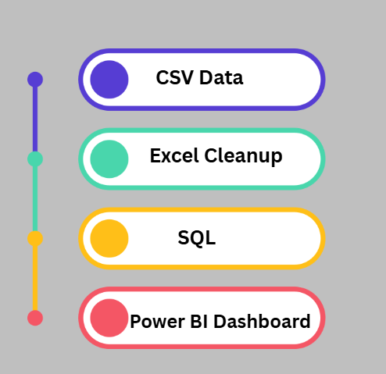
Data Architecture & Tools:
📁 Data Used:
Outpatient & Inpatient Waitlist Data (2018–2021)
Specialty, Case Type, Age Group, Time Band, Total Patients, Archive Date
Specialty Mapping Table
Maps each Specialty to a Specialty Group (e.g., Surgical, Cardiology, ENT)
🔗 Data Pipeline:
Excel
⚙️ Tech Stack
SQL
Power BI

Slide 4
Waitlist Surge Overview
📌 Latest Month Waitlist: 709K
📌 YoY Increase: +69K patients
📌 Implication: System is under strain; needs intervention.
Case Type Load Split
📌 Outpatient = 72% of waitlist
📌 Inpatient & Day Case = minority
📌 Implication: Focus improvements in outpatient scheduling + capacity
Dashboard Insights Overview:
Most Affected Groups
📌 Age Band 16–64 has the longest waits
📌 Top Delay Specialties:
Paediatric Dermatology (168)
Orthopaedics (115)
📌 Implication: Need prioritization in certain specialties & demographics.

Slide 5

Insights & Recommended Actions:
Insights
Action needed / Suggested
🧑‍⚕️ Outpatients form 72% of total waitlist
🔧 Prioritize outpatient scheduling and capacity planning
👶 Pediatric Dermatology shows longest median wait (168 days)
👨‍⚕️ Allocate more specialists and resources to reduce pediatric delays
📈 Waitlist increased by 69K YoY (11% surge)
📅 Enable proactive monthly tracking and early alert systems
⏳ Significant patients waiting >18 months (esp. Day Case & Inpatient)
⚠️ Set thresholds and fast-track long-wait cases
👥 Age group 16–64 has largest representation
📌 Customize intervention strategies: weekend slots, teleconsults, reminders

Slide 6
Conclusion & Strategic Value:
✅ Key Takeaways:
🎯 Purpose-Driven Dashboard Designed to identify long wait times and specialty-level bottlenecks in real time
🏥 Stakeholder Empowerment Admins, doctors, and operations teams get actionable insights via dynamic filtering (age, region, specialty)
🚀 Strategic Impact Supports smarter decisions in patient prioritization and resource allocation
🔄 Scalable Framework Ready to be adapted for other hospitals, departments, or national-level rollouts
🛠️ Robust Tech Stack Built using Power BI, SQL, Excel — easily maintainable and expandable

